Slide 1
Introduction to Graphics Programming and its Applications
繪圖程式設計與應用
GLUT
Instructor: Hung-Kuo Chu
Department of Computer Science
National Tsing Hua University
CS4505

Slide 2
Software Organization
application program
X, Win32, Mac O/S
GLUT
GLU
OpenGL Motif widget or similar
GLX, AGL or WGL
GL
Software and/or hardware

Slide 3
GLUT (OpenGL Utility Toolkit)
Provides functionality common to all window systems
Open a window
Get input from mouse and keyboard
Menus
Event-driven

Slide 4
GLUT (OpenGL Utility Toolkit)
GLUT was originally written by Mark Kilgard to support the sample programs in the second edition OpenGL 'RedBook‘
The original GLUT project is no longer maintained; We use FreeGLUT nowadays.
Latest version: FreeGLUT 3.0.0
You may also want to use: GLFW

Slide 5
Using GLUT : Step-by-Step
Create a new project
Setup development environment
Open a new window
Register callback functions
Initialize OpenGL states
Entering main loop
Rendering
Event handle

Slide 6
Preliminaries
GLUT library (FreeGLUT) files
Header files
freeglut.h
freeglut_ext.h
freeglut_std.h
glut.h
Library file
freeglut.lib
Binary file
freeglut.dll

Slide 7
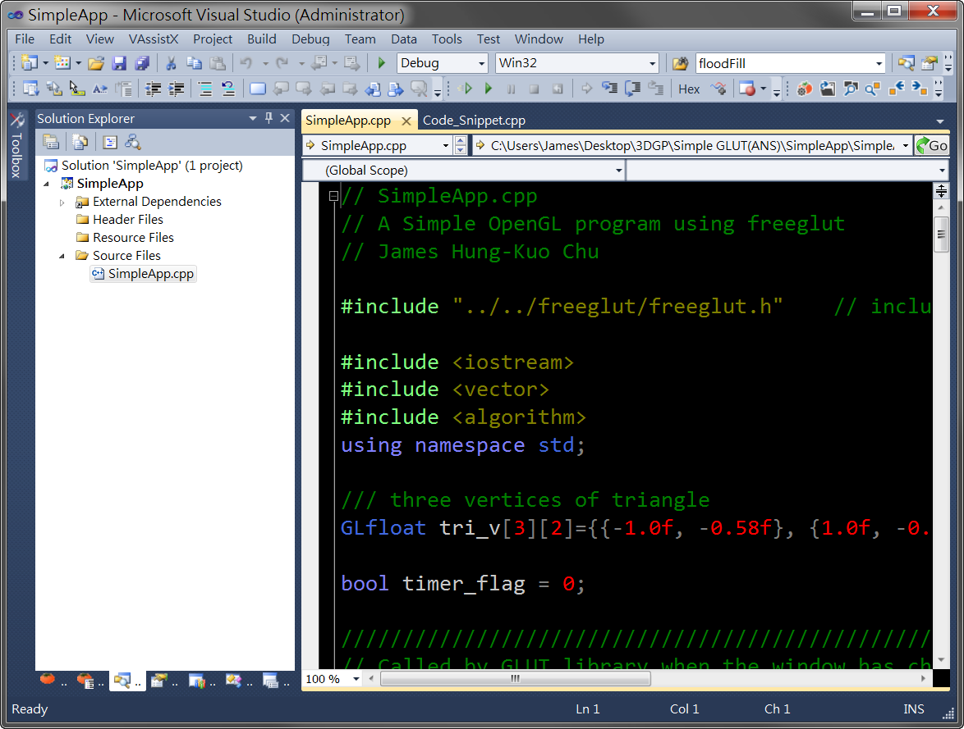
VS 2010 Quick Guide
Menu
Toolbar
VAssistX
(optional)
Solution Explorer
Editor

Slide 8
Create a New Project
Visual Studio 2010

Slide 9
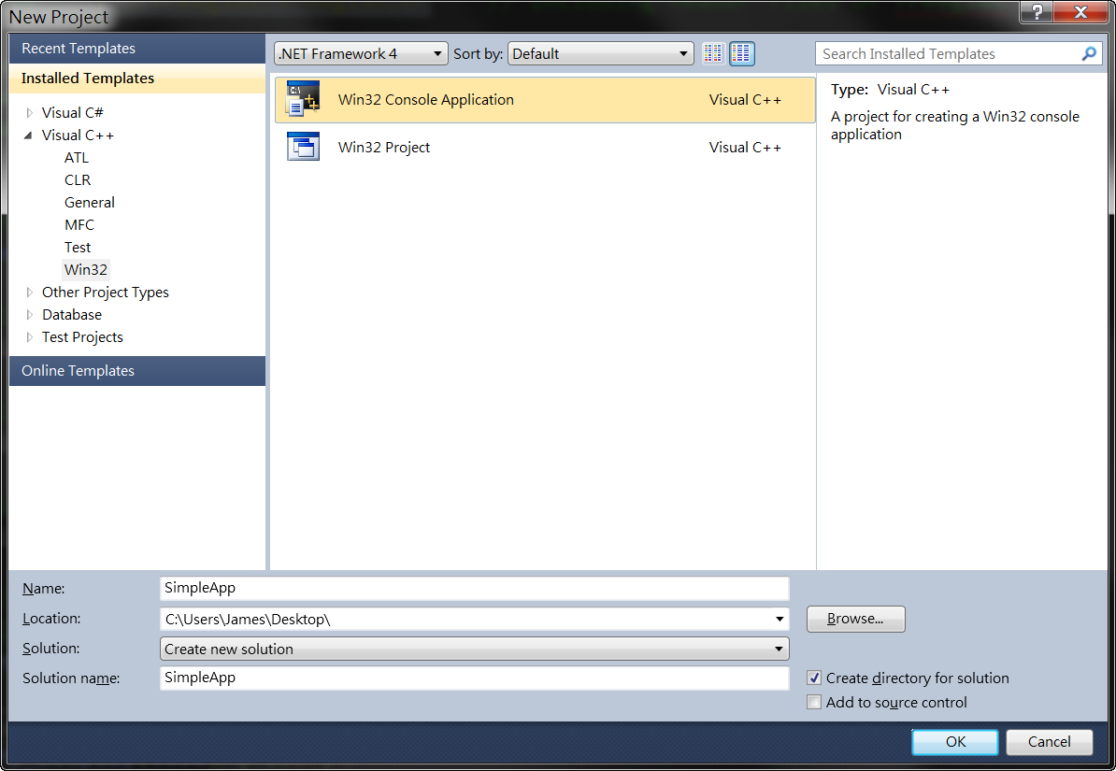
Win32 Console Application

Slide 10
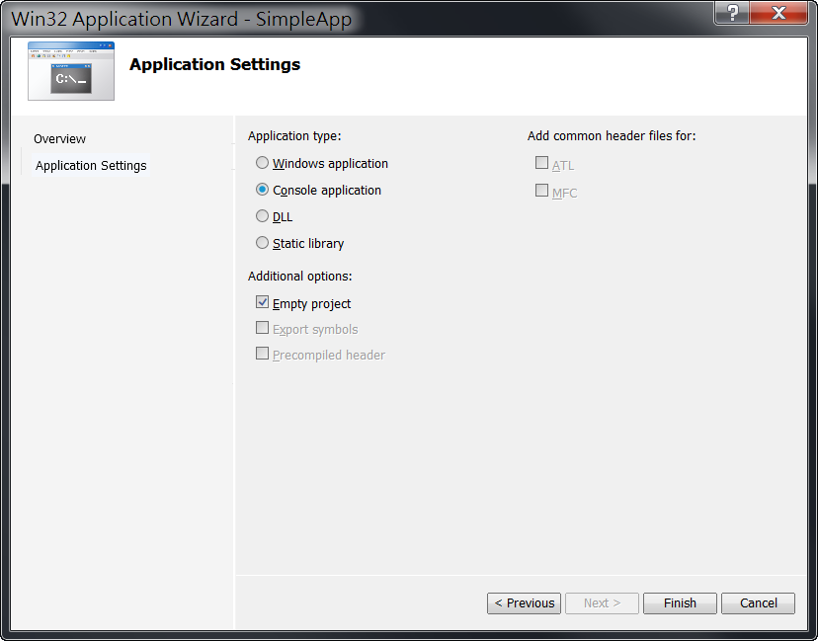
Project Setting

Slide 11
Setup Development Environment

Slide 12
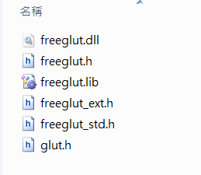
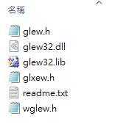
General Steup
Download and unzip freeglut & glew package
Copy “freeglut.dll” “glew32.dll” to
System32 (x86) or SysWOW64 (x64)

Slide 13
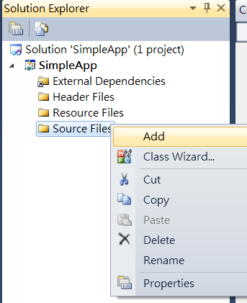
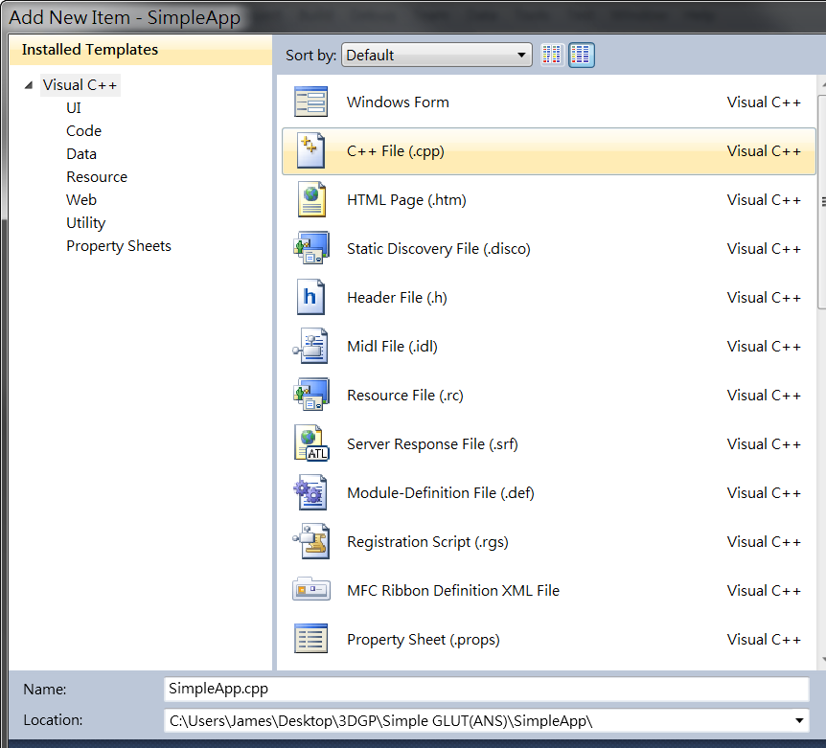
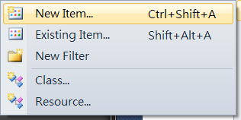
Create a New Source File
Solution Explorer -> Mouse right click “Source Files (原始檔)“->Add->New Item

Slide 14


Local Setup (Recommended)
Copy freeglut, glew folder to somewhere nearby your project
Including the freeglut, glew header file

Slide 15
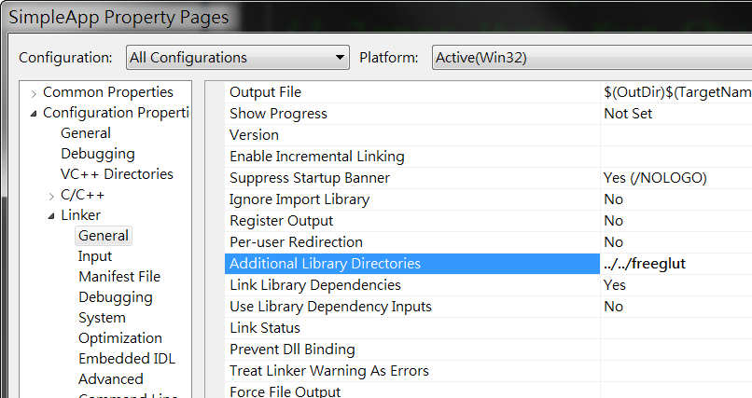
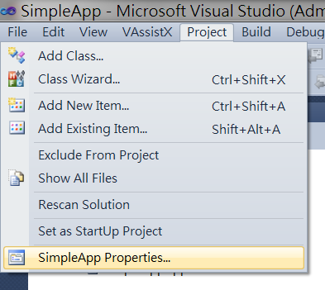
Local Setup (Recommended)
Add the freeglut, glew lib path

Slide 16
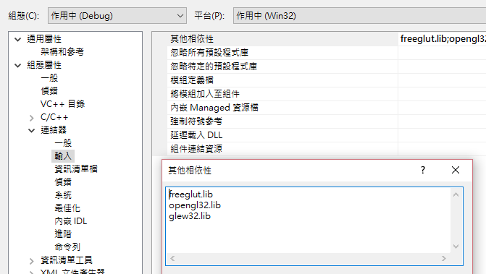
Local Setup (Recommended)
Add freeglut.lib, opengl32.lib, glew32.lib to dependencies

Slide 17
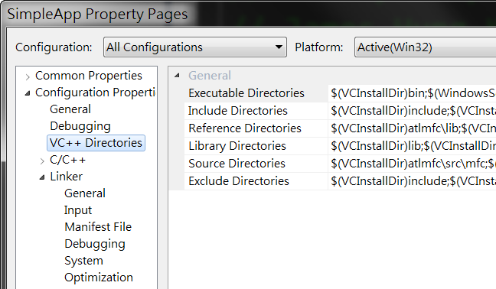
Global Setup
Put freeglut, glew folder to somewhere you like and open the project “properties”

Slide 18

Global Setup
Add absolute freeglut, glew folder path to
“Include Directories”
“Library Directories”
Including the freeglut, glew header like this

Slide 19
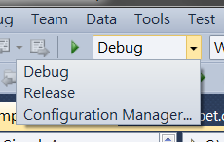
Frequently Used Tools
Configuration Manager
Debug mode: If you meet bugs…
Release mode: Make your codes run faster!

Slide 20

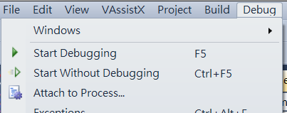
Frequently Used Tools
Compile and execute the codes
Runtime speed:
(Release+2) > (Release+1) > (Debug+2) > (Debug+1)
1. Start Debugging
2. Start W.O. Debugging

Slide 21
Tricks
When you build a solution or project, VS will usually generate a lot of garbage files of big size!
Please feel free to delete the following files when you upload the HW/project or share your codes to others!
*.sdf, *.suo, folder “ipch”, “Release”, “Debug”
Remember to make a copy of “exe” file before deleting “Release” or “Debug” folders!

Slide 22
Open a New Window

Slide 23
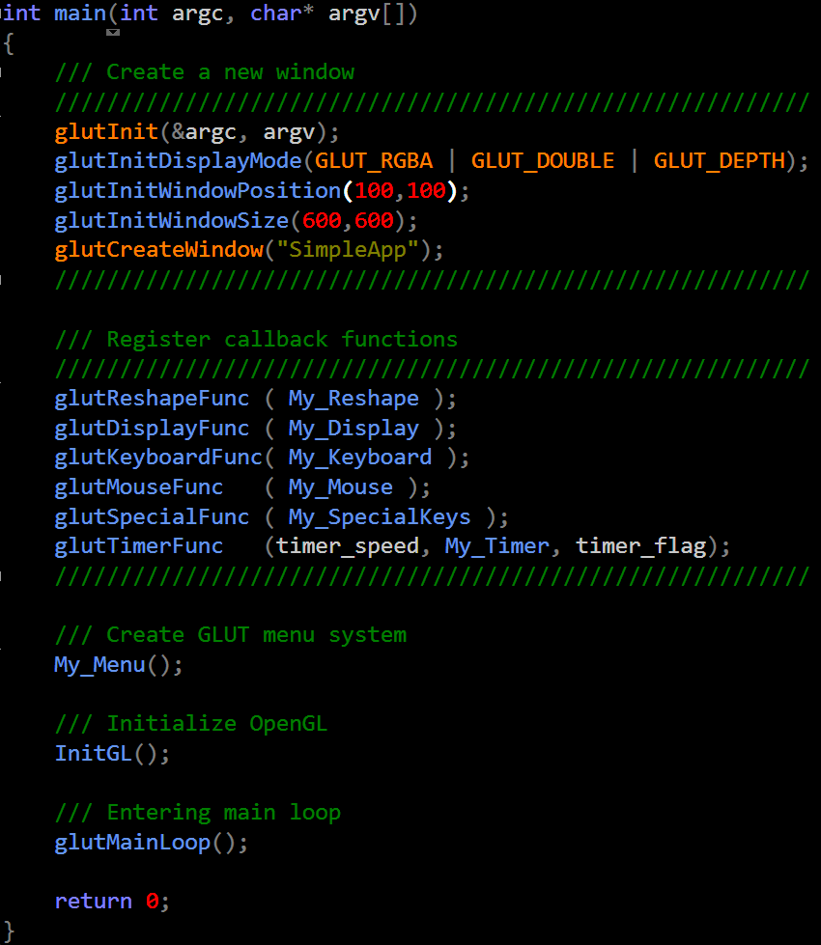
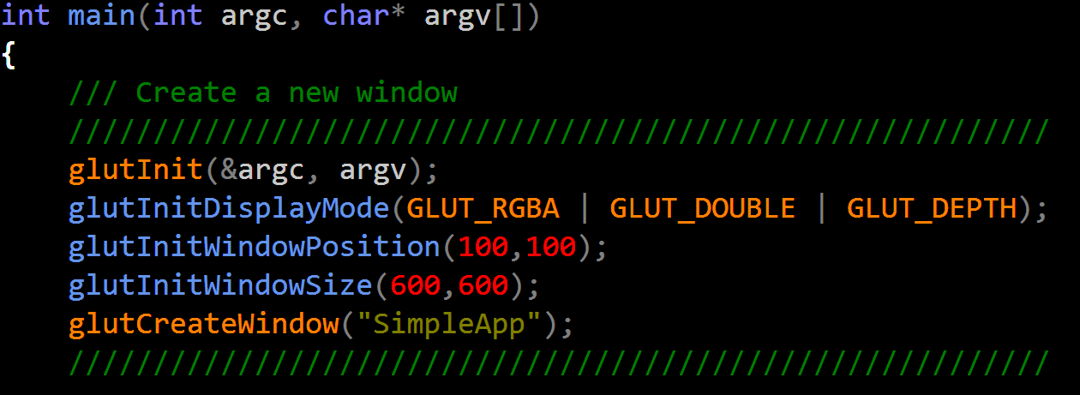
Code Snippet

Slide 24
glutInitDisplayMode()
Specify required data for each pixel in frame buffer
GLUT_RGBA
RGBA color mode
GLUT_DOUBLE
A double-buffered window
GLUT_DEPTH
Allocate depth information

Slide 25
Double Buffering
The drawing commands are actually executed on an off-screen buffer and then quickly swapped into view on the window later.
Avoid flashing effect when doing animation

Slide 26
Double Buffering cont.
Instead of one color buffer, we use two
Front Buffer: one that is displayed
Back Buffer: one that is written to
Program then requests a double buffer in
glutInitDisplayMode(GL_RGB | GL_DOUBLE)
At the end of the display callback buffers are swapped using glutSwapBuffers() command

Slide 27
Initialize OpenGL States

Slide 28
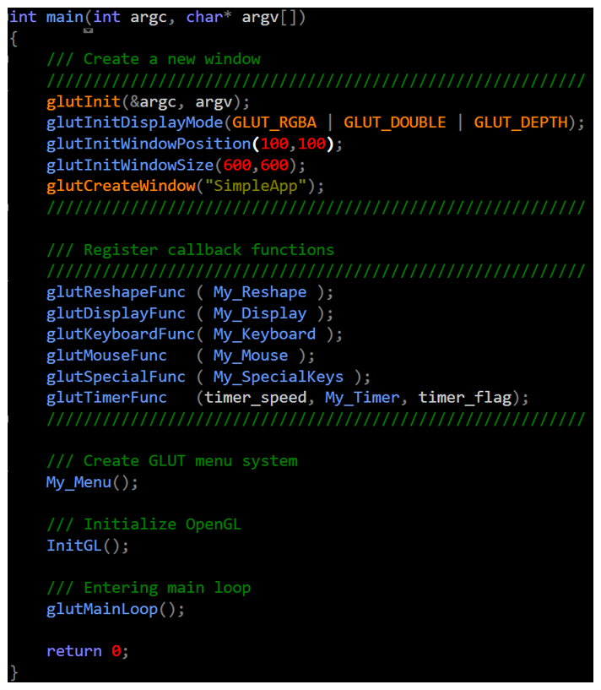
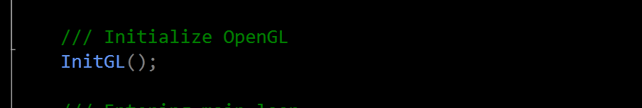
Code Snippet

Slide 29
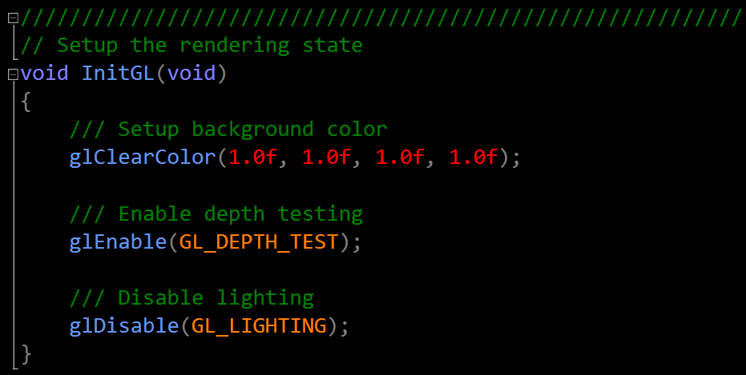
InitGL() - Code Snippet
Setup OpenGL initial states

Slide 30
Create GLUT Context Menu

Slide 31
Menus
GLUT supports pop-up menus
A menu can have submenus
Three steps
Define entries for the menu
Define action for each menu item
Action carried out if entry selected
Attach menu to a mouse button

Slide 32
Defining a Simple Menu
menu callback
entries that appear when
right button depressed
identifiers
menu_id = glutCreateMenu(menu_main_func);
glutAddMenuEntry(“clear Screen”, 1);
glutAddMenuEntry(“exit”, 2);
glutAttachMenu(GLUT_RIGHT_BUTTON);
clear screen
exit
specify the action that triggers the menu

Slide 33
Menu Actions
Menu callback
Note each menu has an id that is returned when it is created
Add submenus by
glutAddSubMenu(char *submenu_name, submenu id)
void menu_main_func(int id)
{
if(id == 1) glClear();
if(id == 2) exit(0);
}
entry in parent menu

Slide 34
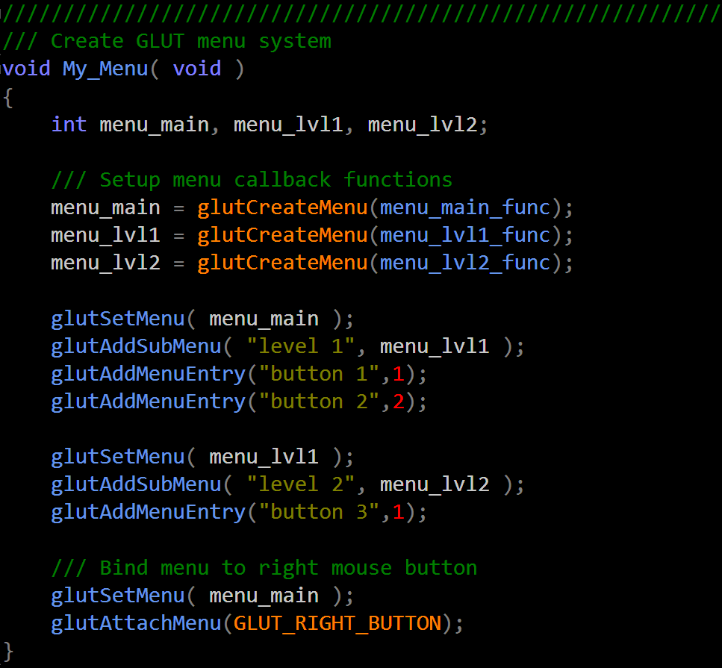
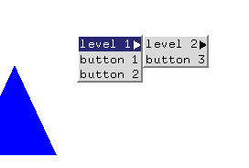
Code Snippet

Slide 35
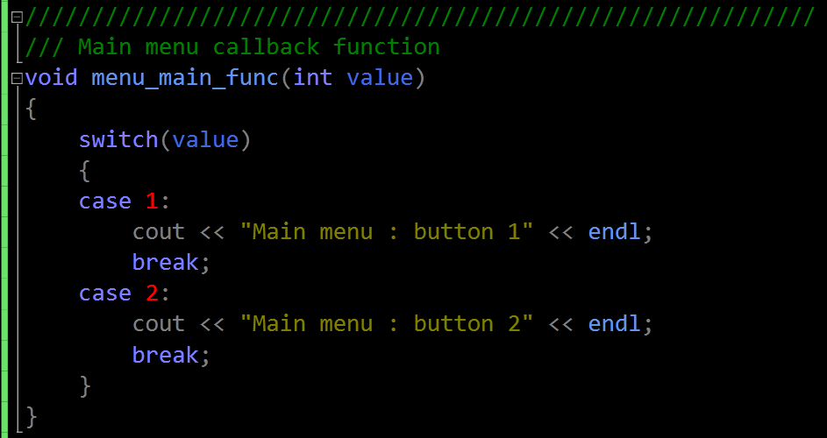
menu_main_func() - Code Snippet
Callback function for main menu

Slide 36
Register Callback Functions

Slide 37
Callbacks
Programming interface for event-driven input
Define a callback function for each type of event the graphics system recognizes
This user-supplied function is executed when the event occurs

Slide 38
GLUT Callbacks
GLUT recognizes a subset of the events recognized by any particular window system (Windows, X, Macintosh)
glutDisplayFunc
glutMouseFunc
glutReshapeFunc
glutKeyboardFunc
glutTimerFunc
glutIdleFunc

Slide 39
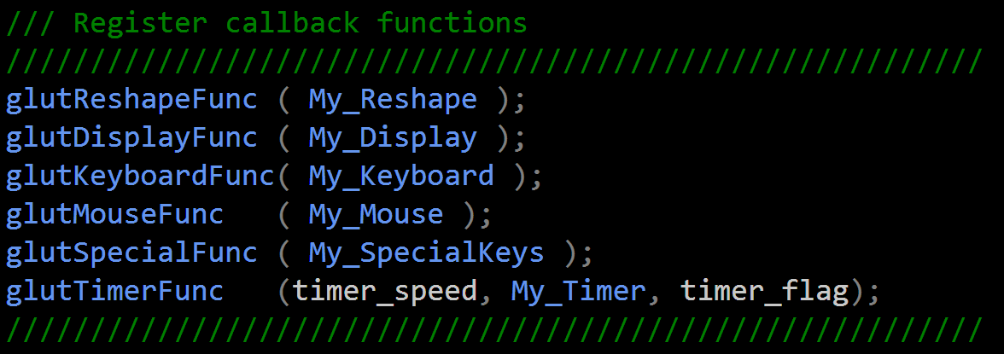
Code Snippet

Slide 40
The Reshape Callback
glutReshapeFunc(myreshape)
void myreshape( int w, int h)
Returns width and height of new window (in pixels)
A redisplay is posted automatically at end of execution of the callback
GLUT has a default reshape callback but you probably want to define your own
The reshape callback is good place to put viewing functions because it is invoked when the window is first opened

Slide 41
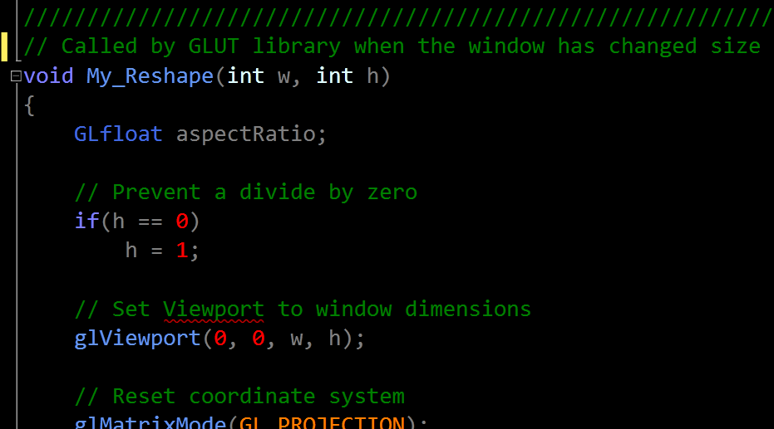
My_Reshape() - Code Snippet
Whenever the window is resized glut calls this function
Width and height of new window

Slide 42
The Display Callback
The display callback is executed whenever GLUT determines that the window should be refreshed, for example
When the window is first opened
When the window is reshaped
When a window is exposed
When the user program decides it wants to change the display
Every GLUT program must have a display callback

Slide 43
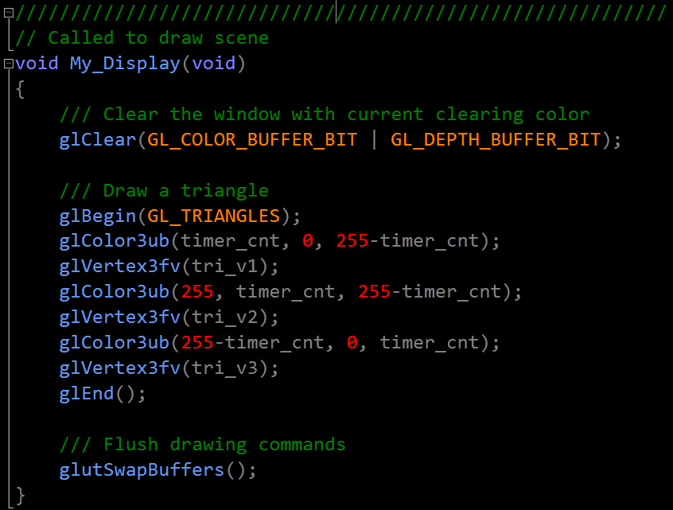
My_Display() - Code Snippet
Call glutSwapBuffers to swap back/front buffers

Slide 44
The Mouse Callback
glutMouseFunc(mymouse)
void mymouse(GLint button, GLint state, GLint x, GLint y)
Returns
which button
GLUT_LEFT_BUTTON
GLUT_MIDDLE_BUTTON
GLUT_RIGHT_BUTTON
state of that button
GLUT_UP
GLUT_DOWN
Position in window

Slide 45

Positioning
The position in the screen window is usually measured in pixels with the origin at the top-left corner
Consequence of refresh done from top to bottom
OpenGL uses a world coordinate system with origin at the bottom left
Must invert y coordinate returned by callback using y_{ogl} = h – y_{win};
Window’s origin
h
OpenGL’s origin
w

Slide 46
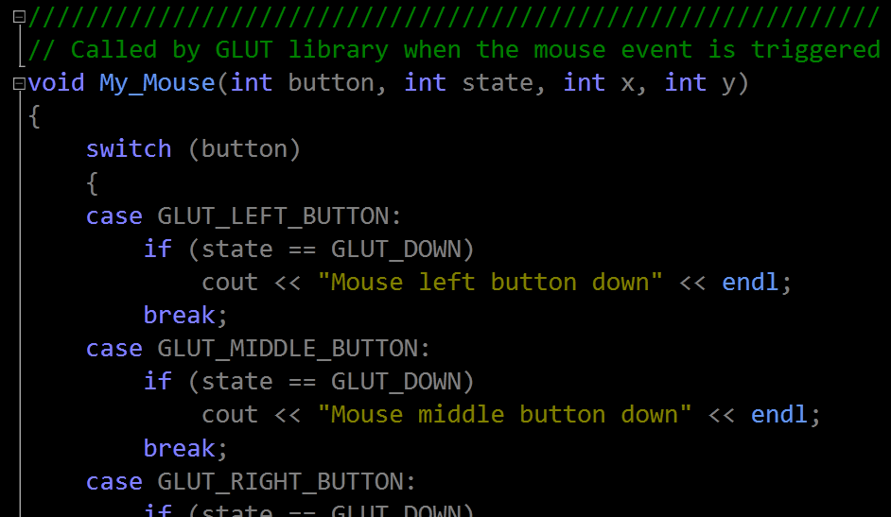
My_Mouse() - Code Snippet
Handle the mouse events
Which button ?
Screen coordinates
Up or down ?

Slide 47
The Keyboard Callback
glutKeyboardFunc(mykey)
void mykey(unsigned char key, int x, int y)
Returns ASCII code of key depressed and mouse location
Can also check of one of the modifiers is depressed by glutGetModifiers()
GLUT_ACTIVE_SHIFT
GLUT_ACTIVE_CTRL
GLUT_ACTIVE_ALT
Allows emulation of three-button mouse with one- or two-button mice

Slide 48
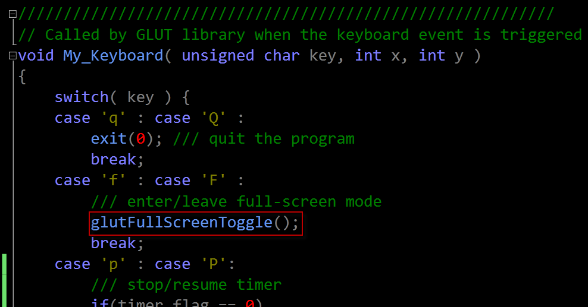
My_Keyboard() - Code Snippet
Handle the keyboard events

Slide 49
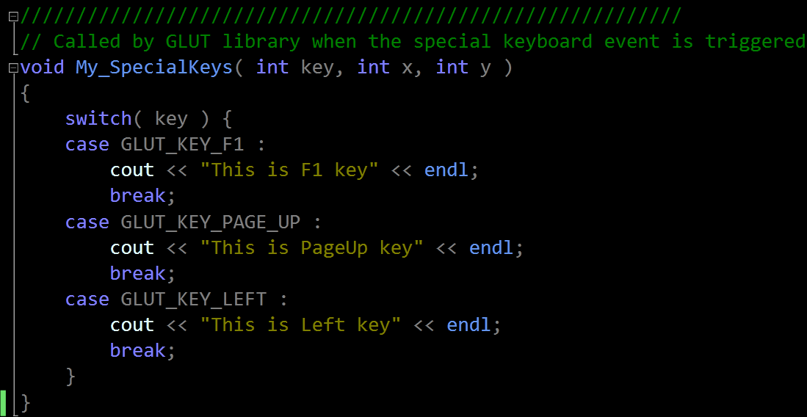
My_SpecialKeys() - Code Snippet
Handle the special keyboard events

Slide 50
Animation in GLUT
glutTimerFunc
Register a timer callback to be triggered in a specified time period using milliseconds (Only once!).
Multiple timer callbacks at same or differing times
Call glutPostRedisplay to refresh the screen
void glutTimerFunc( unsigned int msecs , void (*func)(int value), value);

Slide 51
Animation in GLUT alternative
glutIdleFunc
Sets the global idle callback.
Only one idle function
Can be easily stopped by
Call glutPostRedisplay to refresh the screen
void glutIdleFunc ( void (*func)());
glutIdleFunc ( NULL );

Slide 52
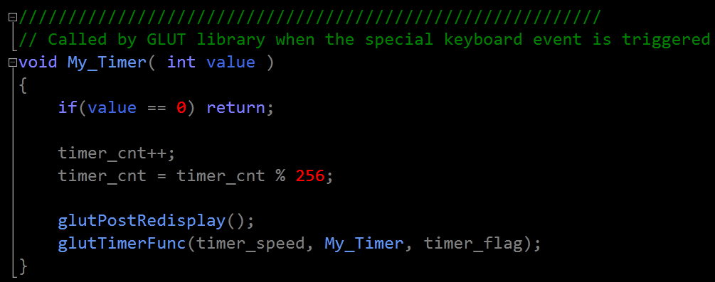
My_Timer() - Code Snippet

Slide 53
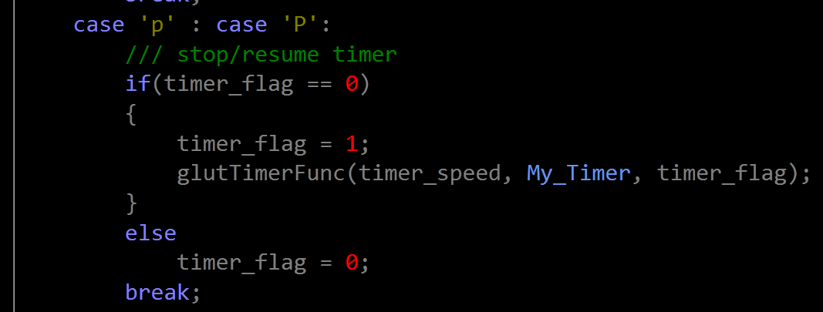
Stop / Resume Timer

Slide 54
Entering Main Loop

Slide 55
GLUT Event Loop
Recall that the last line in a program using GLUT must be
glutMainLoop();
which puts the program in an infinite event loop
In each pass through the event loop, GLUT looks at the events in the queue for each event in the queue, GLUT executes the appropriate callback function if one is defined if no callback is defined for the event, the event is ignored

Slide 56
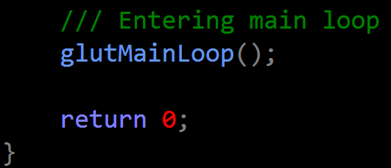
Code Snippet

